Slide 1
Xen Based GPU Virtualization - VirtIO / Passthrough
Ray Huang (Huang Rui) <ray.huang@amd.com>
CLK - China Linux® Kernel 2023

Slide 2







Who are we?
Ray Huang - China
Kernel (GPU, Xen)/QEMU/Xen
Julia Zhang - China
Mesa 3D (OpenGL, Vulkan)/Virglrenderer/QEMU
Honglei Huang - China
Mesa Multimedia/Virglrenderer/QEMU/ROCm
Jiqian Chen - China
Kernel (GPU, Xen)/QEMU/Xen
Pierre-Eric Pelloux-Prayer - France
Mesa 3D (OpenGL, Vulkan)/Virglrenderer/QEMU
Xenia Ragiadakou - Greece
Xen/QEMU/Kernel (Xen)
Leo Liu - Canada
Mesa Multimedia/Virglrenderer
Boyuan Zhang - Canada
Mesa Multimedia/Virglrenderer
Robert Beckett - United Kingdom
Mesa 3D (OpenGL, Vulkan)/Virglrenderer/QEMU

Slide 3
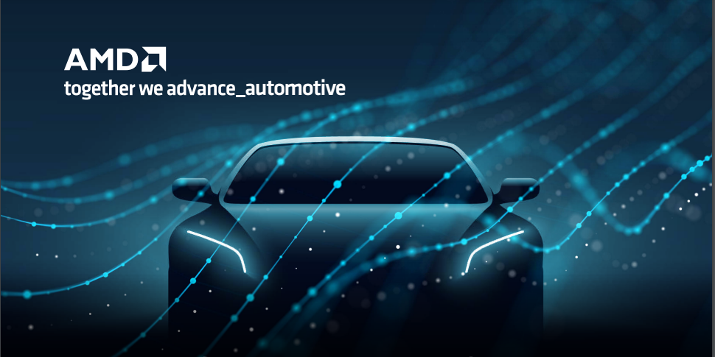
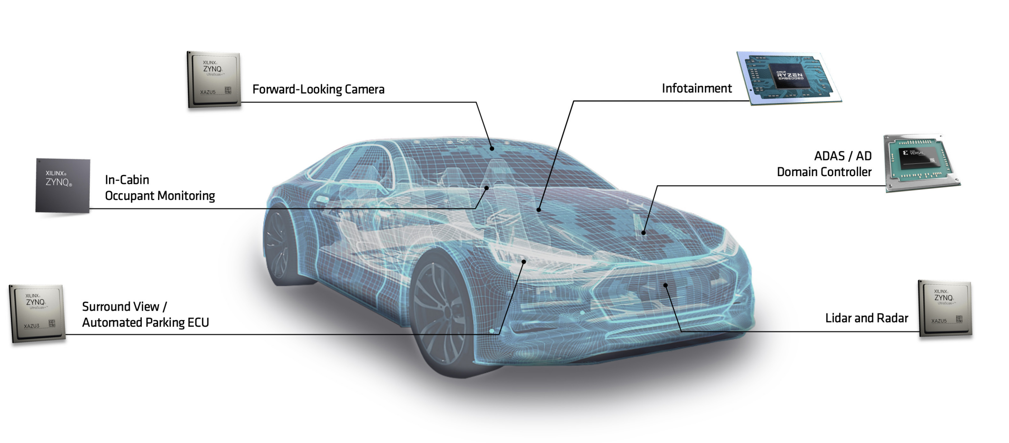
Intention
Automotive Infotainment on AMD
Multiple Systems (Guest VM) in one Car
Xen based GPU Virtualization
3D Graphic and Multimedia hardware acceleration

Slide 4


Technical Background
VirtIO GPU - Only Virgl
Virgl is a 3D OpenGL implementation for VirtIO GPU
Not fully verified on Xen
No Vulkan support
DOM0 PV on x86 CPU
PV is using the swiotlb for DMA operations on all PCI devices
However, in AMD GPU use cases, there are always many large sized buffer mappings as large as Mbytes or Gbytes on the device. Swiotlb is not usable for GPU
PCI Passthrough on PV dom0
GPU passthrough is a very popular use case for virtualization
But it only can be mapped into one guest DOMU
Passthrough is only supported under PV dom0

Slide 5
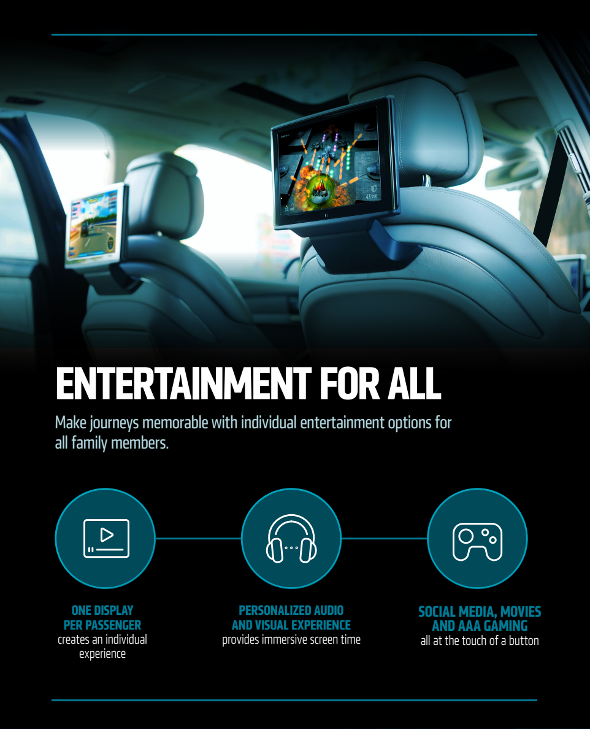





New Proposal to improve GPU virtualization on Xen
Graphic stack including OpenGL and Vulkan
Improve OpenGL support in guest domU
Add Vulkan support in guest domU
Steam games and graphic benchmark coverage
Xen PVH dom0 for AMDGPU on x86 CPU
Support native AMDGPU kernel on dom0
Support PCIe Passthrough for AMDGPU on PVH dom0
Multiple types of GPUs support in one guest DOMU
VirtIO GPU and Passthrough GPU transaction together
Multiple VirtIO GPUs together

Slide 6


GPU Passthrough on Xen PVH DOM0
Kernel
Unmask gsi (New for PVH dom0)
io_apic_write - trap into Xen hypervisor
Reset Device's state (New for PVH dom0)
PHYSDEVOP_pci_device_state_reset
QEMU
Config initialization
Get real device base info
Initialize emulated registers
Map gsi to pirq
Translate irq to gsi(New for PVH dom0)
Use gsi to do PHYSDEVOP_map_pirq
IO Port/Memory Mapping
XEN_DOMCTL_ioport_mapping and XEN_DOMCTL_memory_mapping
Linux® PVH (DOM0)
Ubuntu Linux®
(DOMU)
QEMU
xen_pt_realize
Xserver/Wayland
LibXL PCI
xen_host_pci_device_get
Mesa
xen_pt_register_regions
DRI Interface/ICD Interface
PCI assignable add / remove
xc_physdev_map_pirq
xen_pt_region_update
RadeonSi
Radv
DOM0 Kernel
LibDRM
Xen x86 PCI
Kernel
unmask_irq
Xen Pciback
xc_domain_memory_mapping
Kernel AMD GPU
Xen Hypervisor
vioapic_hwdom_map_gsi
PHYSDEVOP_pci_device_state_reset
XEN_DOMCTL_memory_mapping
VBIOS/Firmware
Discrete GPU (PCIe)
Platform

Slide 7
Blob Memory Introduction
Blob Memory Usage
VirtIO GPU Driver: Virgl / Venus
AMD Native Driver: RadeonSi / Radv
QEMU on Xen mem-path (No udma-buf on Xen)
Remove udma-buf to support Xen
Virtual GPU local memory - Blob Memory
Add local memory in virtual MMIO bar
Provide the direct memory access like VRAM for virtual GPU
QEMU/Virglrenderer responds the virtio command to create and map the blob memory from guest virtual MMIO bar
device_model_args_hvm = ["-display", "sdl,gl=on", "-device", "virtio-vga gl,context_init=true,blob=true,hostmem=4G"]
[ 19.211594] [drm] Host memory window: 0x200000000 +0x100000000
[ 19.211706] [drm] features: +virgl -edid +resource_blob +host_visible
[ 19.211707] [drm] features: +context_init
[ 19.228967] [drm] number of scanouts: 1
[ 19.229092] [drm] number of cap sets: 3
00:04.0 VGA compatible controller: Red Hat, Inc. Virtio GPU (rev 01) (prog-if 00 [VGA controller])
Subsystem: Red Hat, Inc. Virtio GPU
Physical Slot: 4
Flags: bus master, fast devsel, latency 0, IRQ 32
Memory at f1000000 (32-bit, prefetchable) [size=8M]
Memory at f1b74000 (32-bit, non-prefetchable) [size=4K]
Memory at f1b70000 (64-bit, prefetchable) [size=16K]
Memory at 200000000 (64-bit, prefetchable) [size=4G]
Expansion ROM at 000c0000 [disabled] [size=128K]
Capabilities: <access denied>
Kernel driver in use: virtio-pci

Slide 8
Blob Memory to Local GPU buffer on Xen
Guest Mesa (Virgl/Venus or Native Context)
Be able to use blob memory for direct access in the guest instead of command transfer
Guest Kernel
Expose a MMIO bar in PCI config space for blob memory. (hostmem)
Blob Memory Commands in QEMU
Provide blob memory commands implementation
Virglrenderer
Get the host virtual address of local GPU buffer which exposed by DMA-BUF
Xen
Convert the host virtual address to host physical address to connect it with guest physical address with hypervisor calls
Only can be used for pining buffer (no eviction) - challenge
VirtIO GPU PCIe Device
Guest Buffer Object
Hostmem (MMIO BAR)
QEMU
Xen
VirtIO GPU
Guest PFN
MemoryRegion
map_hva_to_gpfns
virtio-gpu resource
Mapping host buffer to guest
xc_domain_add_to_physmap_batch
xc_domain_memory_mapping
Host PFN
Virglrenderer
Virgl Resource
MMAP DMA-BUF
Kernel
AMDGPU Buffer

Slide 9
Virgl and Venus
Linux® PVH (DOM0)
Ubuntu Linux®
(DOMU)
Bring up Venus Support on Xen
No Vulcan is functional on Xen guest based on VirtIO GPU
Implement blob memory support with virtio-gpu-virgl in QEMU
Implement the use case to import a blob resource of external vulkan with OpenGL while egl is not initialized
Virglrenderer
https://gitlab.freedesktop.org/virgl/virglrenderer/-/merge_requests/1068
Mesa
https://gitlab.freedesktop.org/mesa/mesa/-/merge_requests/23680
QEMU - Blob Memory
https://lore.kernel.org/qemu-devel/20230915111130.24064-1-ray.huang@amd.com
QEMU
virtio-gpu-virgl cmd
virtio-gpu-virgl blob memory commands
Xserver/Wayland
Virglrenderer
Mesa
Virglrenderer cmd
DRI Interface/ICD Interface
Vrend context
Vkr context
Mesa
OpenGL
Vulkan
Virgl
Venus
LibDRM
LibDRM
DOM0 Kernel
Kernel
Kernel DRM AMDGPU (iGPU)
Kernel VirtIO GPU
Xen Hypervisor
SBIOS/VBIOS/Firmware
APU (integrated GPU) Platform
Platform

Slide 10
Virgl Video
Linux® PVH (DOM0)
Ubuntu Linux® (DOMU)
Introduce Virgl Video on Xen
Support multiple video codec
Mpeg12/VC1/JEPG/HEVC10bit/VP9
Virgl video corresponding behavior of VM VAAPI in host
Initial VAAPI when the VM starts.
Create Vasurface
Create a true config and context for this decoding in host
Start the actual decoding process in host while VM calls renderPictures()
Mesa/Virglrenderer
https://gitlab.freedesktop.org/mesa/mesa/-/merge_requests/22108
https://gitlab.freedesktop.org/virgl/virglrenderer/-/merge_requests/1068
QEMU
App (ffmpeg / mpv)
virtio-gpu-virgl cmd
Virglrenderer
EGL
VAAPI
Virglrenderer cmd
Vrend context
Vkr context
wayland
Mesa
Mesa
virgl
Virgl Video
OpenGL
Vulkan
LibDRM
LibDRM
DOM0 Kernel
Kernel
Kernel DRM AMDGPU (iGPU)
Kernel VirtIO GPU
Xen Hypervisor
SBIOS/VBIOS/Firmware
APU (integrated GPU) Platform
Platform

Slide 11
VirtIO Native Context
Linux® PVH (DOM0)
Ubuntu Linux®
(DOMU)
VirtIO Native Context with AMDGPU on Xen - Coming
One more straightforward way than Virgl/Venus
API Forward with Libdrm instead of OpenGL/Vulkan interfaces
Leverage blob memory with native OpenGL/Vulkan in the guest
No Mesa running in the host (faster)
Initial the design bases on the work of Bob Clark and refer the corresponding presentation on XDC2022
https://gitlab.freedesktop.org/mesa/mesa/-/merge_requests/21658
QEMU
virtio-gpu-virgl cmd
virtio-gpu-virgl blob memory commands
Xserver/Wayland
Virglrenderer
Mesa
Virglrenderer cmd
DRI Interface/ICD Interface
AMDGPU DRM Renderer context
No Mesa running in Host dom0
RadeonSI
Radv
VirtIO GPU Backend
LibDRM
LibDRM
DOM0 Kernel
Kernel
Kernel DRM AMDGPU (iGPU)
Kernel VirtIO GPU
Xen Hypervisor
SBIOS/VBIOS/Firmware
APU (integrated GPU) Platform
Platform

Slide 12
dGPU Prime on Native Context
Native context: virtio-GPU + passthrough GPU
Two VirtIO GPU
Ubuntu Linux® (DOMU)
Ubuntu Linux® (DOMU)
Xserver/Wayland
Xserver/Wayland
Mesa
Mesa
DRI Interface/ICD Interface
DRI Interface/ICD Interface
create display buffer
create render buffer
create display buffer
create render buffer
RadeonSi
import
RadeonSi
Others
Radeonsi
import
RadeonSi
Others
resource
resource
resource
resource
LibDRM
LibDRM
Kernel
Kernel
Kernel VirtIO GPU
Kernel AMD GPU
Other drivers
Kernel VirtIO GPU
Kernel VirtIO GPU
Other drivers
blob create
blob
create
blob
create

Slide 13
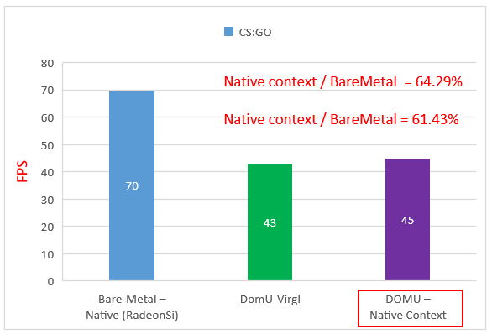
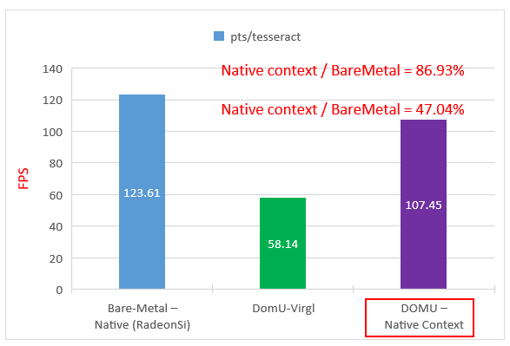
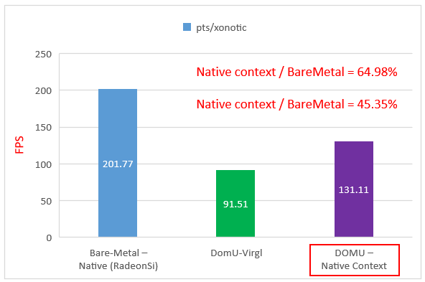
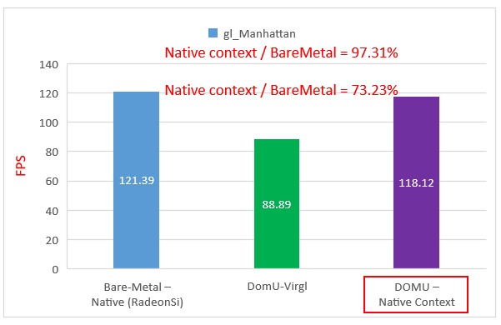
OpenGL Comparison between Virgl and Native Context
Test Cases (Unit: FPS) | Histogram | Bare-Metal – Native (RadeonSi) | DOMU – Virgl | DOMU – Native Context (RadeonSi)
CS:GO |  | 70 | 43 (61.43%) | 45 (64.29)
pts/tesseract |  | 123.61 | 58.14 (47.04%) | 107.45 (86.93%)
pts/xonotic |  | 201.77 | 91.51 (45.35%) | 131.11 (64.98)
GFXBench (gl_Manhattan) |  | 121.39 | 88.89 (73.23%) | 118.12 (97.31%)

Slide 14
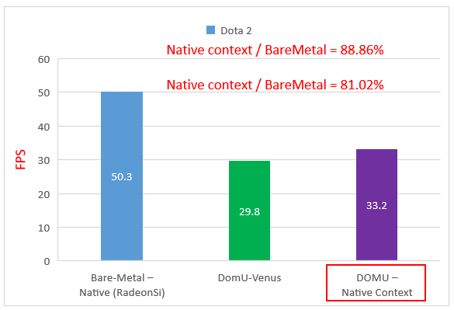
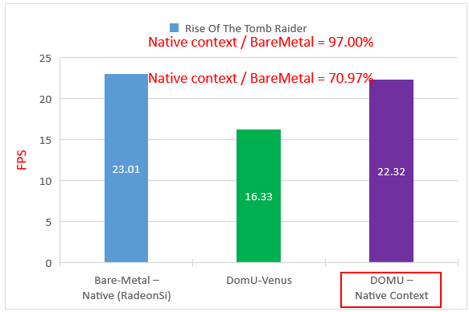
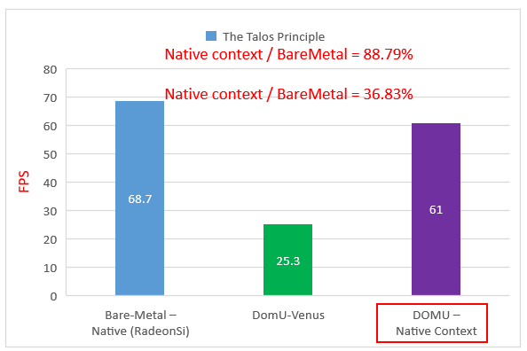
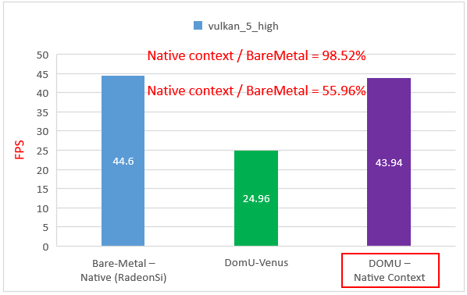
Vulkan Comparison between Venus and Native Context
Test Cases(Unit: FPS) | Histogram | Bare-Metal – Native (Radv) | DOMU – Venus | DOMU – Native Context (Radv)
Dota 2 |  | 50.3 | 29.8 (81.02%) | 33.2 (88.86%)
Rise Of The Tomb Raider |  | 23.01 | 16.33 (70.97%) | 22.32 (97.00%)
The Talos Principle |  | 68.7 | 25.3 (36.83%) | 61.0 (88.79%)
GFXBench (vulkan_5_high) |  | 44.60 | 24.96 (55.96%) | 43.94 (98.52%)

Slide 15


ROCm with VirtIO Native Context - Design Preview
Linux® PVH (DOM0)
Ubuntu Linux®
(DOMU)
QEMU
AMD ROCm on guest DOMU - Coming
Support OpenCL™ over ROCm for virtualization
Also inspired by virtio native context on graphic design
API Forward for Libhsakmt (Thunk)
Introduce VirtIO GPU backend in ROCm runtime and OpenCL™ runtime
Add libhsakmt capacity in QEMU
Leverage blob memory
Add libhsakmt renderer in virglrenderer
Libhsakmt Capset
virtio-gpu-virgl cmd
OpenCL™ Application
virtio-gpu-virgl blob memory commands
Virglrenderer
OpenCL™ Loader
Virglrenderer cmd
OpenCL™ Driver
Libhsakmt Renderer
CL Runtime
Address Traction Layer
No ROCm running in host DOM0
ROCm Runtime
VirtIO GPU Backend
Libhaskmt Thunk
LibDRM
DOM0 Kernel
Kernel
Kernel DRM AMDGPU
AMDKFD
Kernel VirtIO GPU
Xen Hypervisor
SBIOS/VBIOS/Firmware
APU (integrated GPU) Platform
Platform

Slide 16

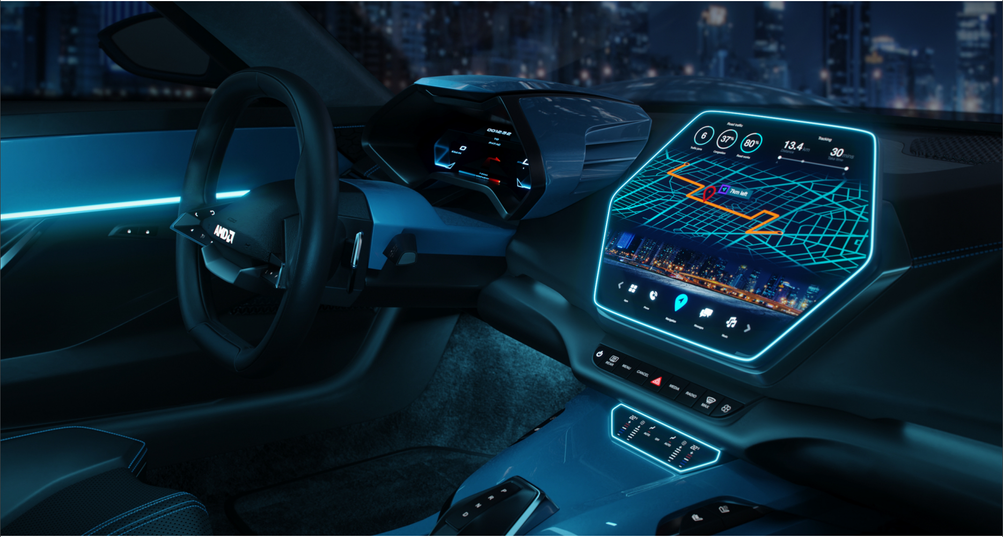


The Best is Yet to Come
Continue upstream for the whole solution - On going
Full graphic benchmark verification
Resolve the direct mapping of virtual MMIO bar for QEMU on Xen
Plan to use an MMU notifier
Implement the approach to enable AMD ROCm compute stack at guest VM with VirtIO
Support leading AI Frameworks over ROCm for virtualization

Slide 17
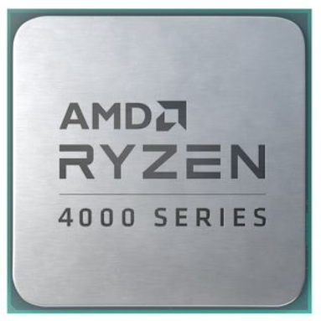
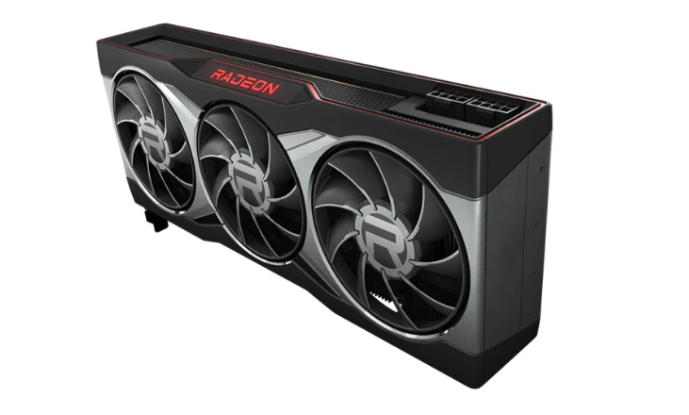
References
Hardware
AMD Ryzen 4000G Series APUs
AMD Radeon™ RX 6000 Series GPUs
Repositories
Kernel - https://git.kernel.org/pub/scm/linux/kernel/git/rui/linux.git/log/?h=upstream-fox-xen
Xen - https://gitlab.com/huangrui123/xen/-/commits/upstream-for-xen
QEMU - https://gitlab.com/huangrui123/qemu/-/commits/upstream-for-xen
Virglrenderer - https://gitlab.freedesktop.org/rui/virglrenderer/-/commits/upstream-for-xen
Mesa - https://gitlab.freedesktop.org/rui/mesa/-/commits/upstream-for-xen
Upstream is in progress
Kernel - https://lore.kernel.org/lkml/20230312120157.452859-1-ray.huang@amd.com/
Xen - https://lore.kernel.org/xen-devel/20230312075455.450187-1-ray.huang@amd.com/
QEMU - https://lore.kernel.org/qemu-devel/20230312092244.451465-1-ray.huang@amd.com/
Virglrenderer - https://gitlab.freedesktop.org/virgl/virglrenderer/-/merge_requests/1068
Mesa (MM) - https://gitlab.freedesktop.org/mesa/mesa/-/merge_requests/22108
Mesa (Native Context) - https://gitlab.freedesktop.org/mesa/mesa/-/merge_requests/21658
Mesa (Venus) - https://gitlab.freedesktop.org/mesa/mesa/-/merge_requests/23680
AMD Radeon™ RX 6000 Series

Slide 18
Thank You and Q&A

Slide 19
Disclaimer:
The information presented in this document is for informational purposes only and may contain technical inaccuracies, omissions, and typographical errors. The information contained herein is subject to change and may be rendered inaccurate for many reasons, including but not limited to product and roadmap changes, component and motherboard version changes, new model and/or product releases, product differences between differing manufacturers, software changes, BIOS flashes, firmware upgrades, or the like. Any computer system has risks of security vulnerabilities that cannot be completely prevented or mitigated. AMD assumes no obligation to update or otherwise correct or revise this information. However, AMD reserves the right to revise this information and to make changes from time to time to the content hereof without obligation of AMD to notify any person of such revisions or changes.
THIS INFORMATION IS PROVIDED ‘AS IS.” AMD MAKES NO REPRESENTATIONS OR WARRANTIES WITH RESPECT TO THE CONTENTS HEREOF AND ASSUMES NO RESPONSIBILITY FOR ANY INACCURACIES, ERRORS, OR OMISSIONS THAT MAY APPEAR IN THIS INFORMATION. AMD SPECIFICALLY DISCLAIMS ANY IMPLIED WARRANTIES OF NON-INFRINGEMENT, MERCHANTABILITY, OR FITNESS FOR ANY PARTICULAR PURPOSE. IN NO EVENT WILL AMD BE LIABLE TO ANY PERSON FOR ANY RELIANCE, DIRECT, INDIRECT, SPECIAL, OR OTHER CONSEQUENTIAL DAMAGES ARISING FROM THE USE OF ANY INFORMATION CONTAINED HEREIN, EVEN IF AMD IS EXPRESSLY ADVISED OF THE POSSIBILITY OF SUCH DAMAGES.
© 2023 Advanced Micro Devices, Inc. All rights reserved.
AMD, the AMD Arrow logo, Radeon, Ryzen and combinations thereof are trademarks of Advanced Micro Devices, Inc. Other product names used in this publication are for identification purposes only and may be trademarks of their respective companies. Linux is a trademark of Linus Torvalds and OpenCL is a trademark of Apple Inc. Windows and DirectX are the registered trademarks of Microsoft Corporation in the US and other jurisdictions.

